Slide 1
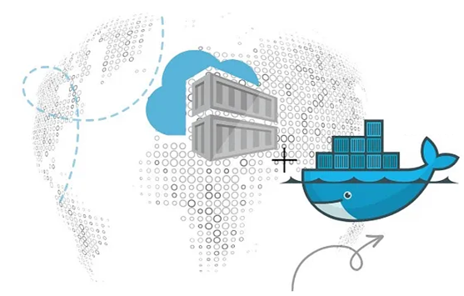
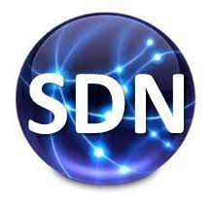
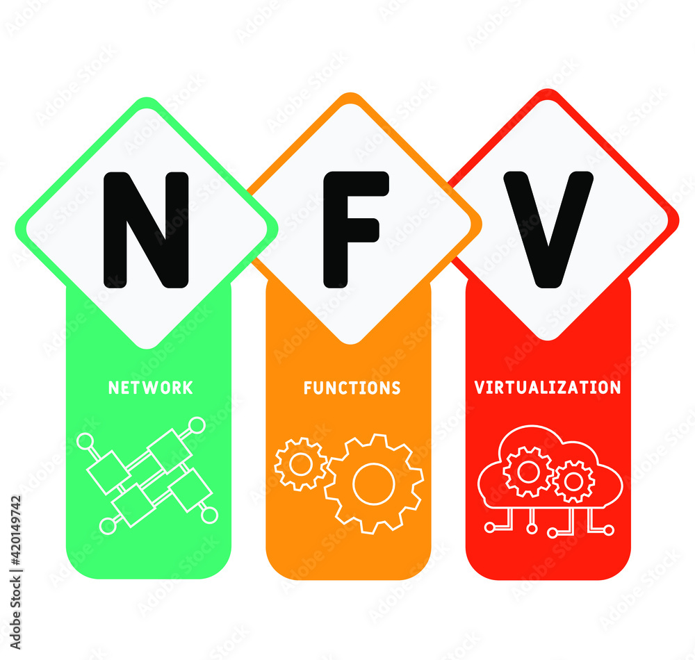
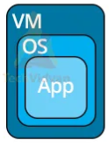
PDS
Computer Vision
Chapter 5_4_Q2:
CoAP
Constrained Application Protocol
MQTT
Message Queuing Telemetry Transport
https://github.com/siagianp
https://www.youtube.com/@AmelOline/videos
https://github.com/amelcharolinesgn2/IoT_simulator-mqtt-NodeRed
https://github.com/amelcharolinesgn2/Cloud-Infrastructures
https://github.com/amelcharolinesgn2/ClouD-Infrastructure-SISKA-2025
Notes:
A IoT oriented presentation http://wireless.ictp.it/school_2017/Slides/MQTT.pdf
Creating Solutions Using MQTT and Raspberry Pi
AronAyubMQTT-and-Raspberry-Pi https://github.com/AronAyub/MQTT-and-Raspberry-Pi
https://medium.com/buildpiper/simplifying-containerization-with-docker-run-command-2f74e114f42a
https://github.com/IBA-Group-IT/IoT-data-simulator
https://www.bevywise.com/blog/docker-mqtt-broker-easy-service-manageability/
https://aws.amazon.com/id/what-is/mqtt/
https://www.kmtech.id/post/berkenalan-dengan-mqtt-protokol-untuk-internet-of-things

Slide 2
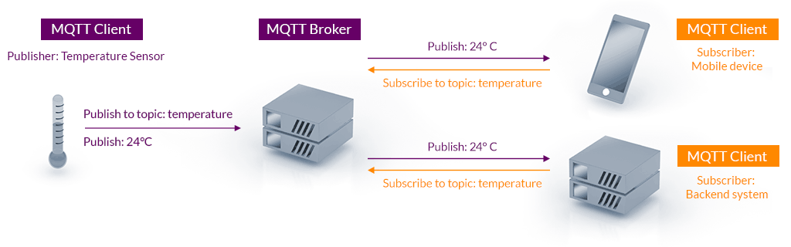
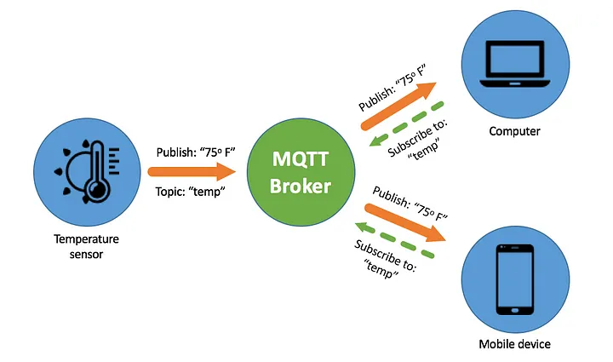
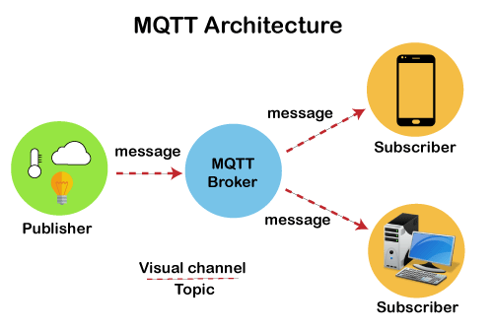
Architecture
MQTT and Messaging protocol
Notes:
https://medium.com/nerd-for-tech/everything-to-know-about-mqtt-message-queue-telemetry-transport-acbf32d1b761
https://nitin-sharma.medium.com/getting-started-with-mqtt-part-1-a3c365e3a488
https://medium.com/nerd-for-tech/creating-a-simple-iot-project-590342f6f904
https://github.com/emqx/blog/blob/main/en/202308/simulating-the-future-crafting-iot-scenarios-with-chatgpt-and-mqttx.md

Slide 3
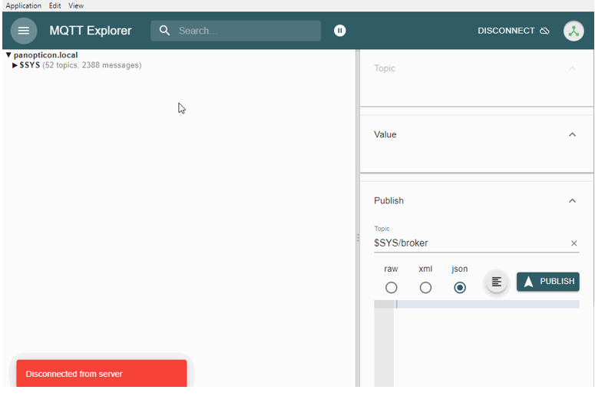

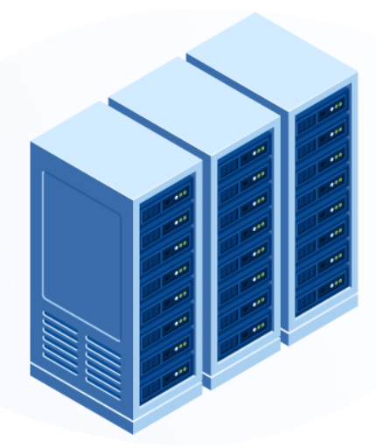
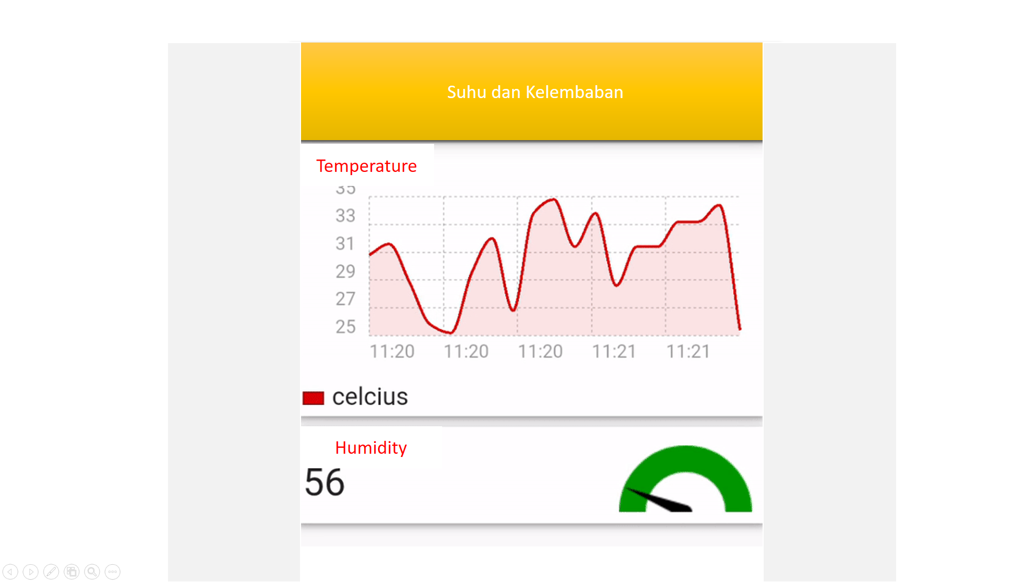
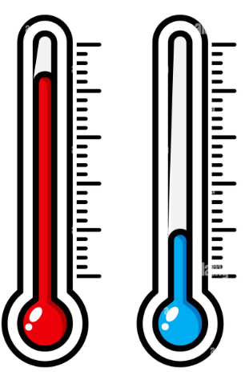

Broker
Subscriber
Broker:
Store and Forward
Filtering
Security
QoS
Subscriber
Publisher:
MQTT Client
MQTT Client
Subcriber

Slide 4
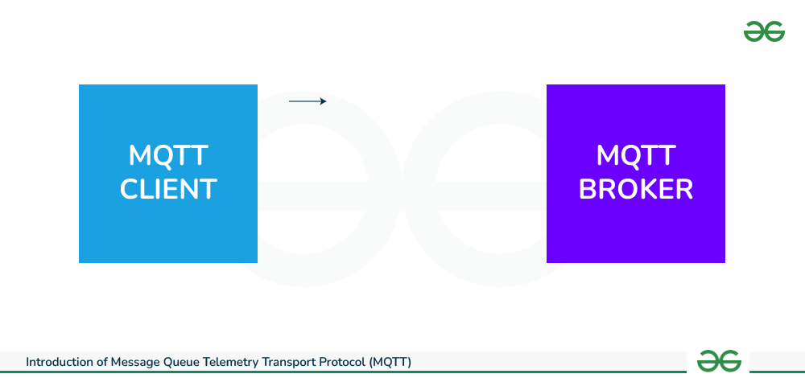
A-1: What is MQTT
The official website definition is a “Client Server publish/subscribe messaging transport protocol. It is lightweight, open, simple, and designed so as to be easy to implement. These characteristics make it ideal for use in many situations, including constrained environments such as for communication in Machine to Machine (M2M) and Internet of Things (IoT) contexts where a small code footprint is required and/or network bandwidth is at a premium.”
MQTT Client
MQTT Broker

Slide 5
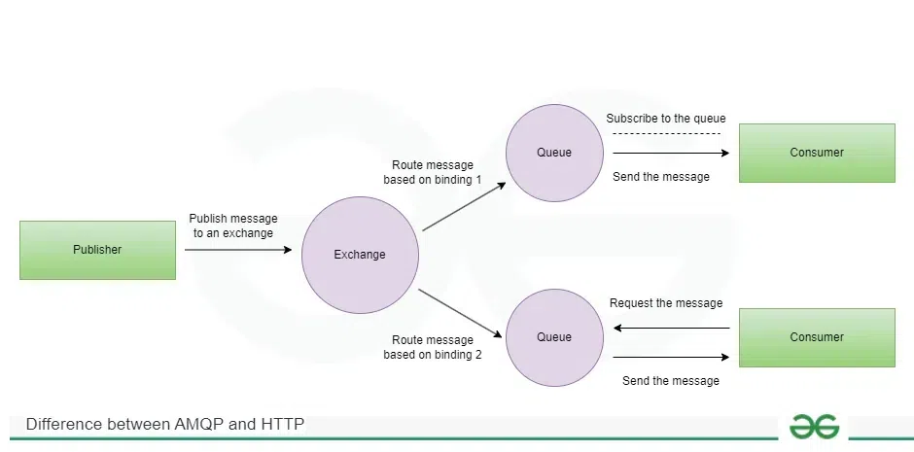
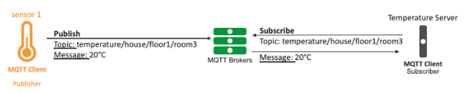
A-2:What is AMQP
Advanced Message Queuing Protocol(AMQP).
Advanced Message Queuing Protocol is an open standard session layer protocol useful for sending transnational messages that is why mainly used in the financial industry. It runs over TCP (Transmission Control Protocol) or UDP (User Datagram Protocol) which is nearly similar to that of MQTT. But only difference is that Broker(Dealer) contains Exchange and Queues as a result it is focused on not losing messages. The exchange receives messages from publishers and distributes them to respective queues. Different subscribers collect topic wise sensory data from respective topic queues.

Slide 6
A-3:What is Constrained Application Protocol (CoAP)
Constrained Application Protocolis a session layer protocol that uses RESTful architecture which is a standard interface between HTTP clients and servers. It uses UDP (User Datagram Protocol) protocol for lightweight implementation so it is based on two sublayers i.e messaging and request/response for interaction. This protocol is designed to address IoT systems based on HTTP protocols. So, CoAP utilizes all HTTP methods like GET, PUT, PUSH, DELETE for message transmission, and accessing resources. It is a specialized web transfer protocol which uses constrained nodes/devices on same constrained networks in Internet of Things.
Constrained Application Protocol adalah protokol lapisan sesi yang menggunakan arsitektur RESTful yang merupakan antarmuka standar antara klien dan server HTTP. Protokol ini menggunakan protokol UDP (User Datagram Protocol) untuk implementasi yang ringan sehingga didasarkan pada dua sublapisan yaitu pengiriman pesan dan permintaan/respons untuk interaksi. Protokol ini dirancang untuk menangani sistem IoT berdasarkan protokol HTTP. Jadi, CoAP menggunakan semua metode HTTP seperti GET, PUT, PUSH, DELETE untuk transmisi pesan, dan mengakses sumber daya. Ini adalah protokol transfer web khusus yang menggunakan node/perangkat terbatas pada jaringan terbatas yang sama di Internet of Things.
Notes:
https://www.geeksforgeeks.org/session-layer-messaging-protocols-in-iot/

Slide 7
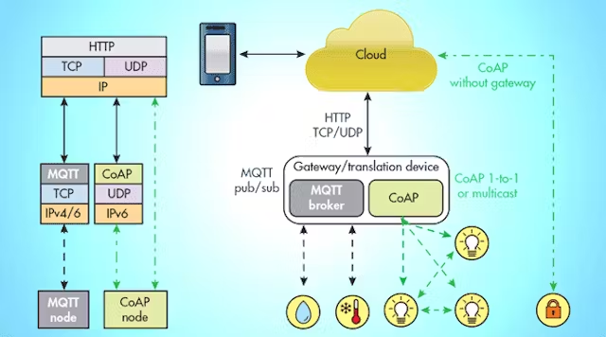
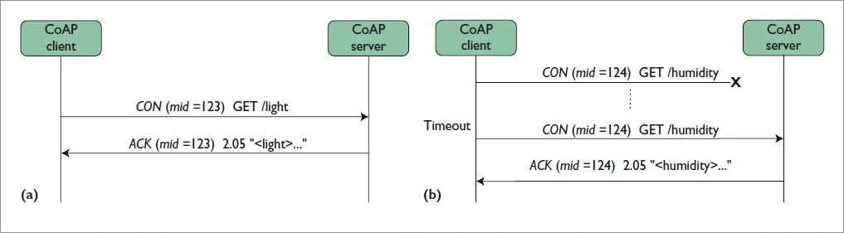

Slide 8
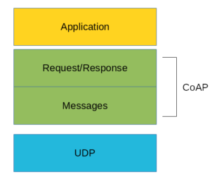
This protocol is used in M2M data exchange and is very similar to HTTP. The main features of CoAP protocols are:
Web protocol used in M2M with constrained requirements
Asynchronous message exchange
Low overhead and very simple to parse
URI and content-type support
Proxy and caching capabilities
There are two different layers that make CoAP protocol: Messages and Request/Response. The Messages layer deals with UDP and with asynchronous messages. The Request/Response layer manages request/response interaction based on request/response messages. CoAP supports four different message types:
Confirmable
Non-confirmable
Acknowledgment
Reset
CoAP Architecture
Notes:
https://www.startertutorials.com/blog/constrained-application-protocol.html

Slide 9
A-4:What is Secure Message Queue Telemetry Transport (SMQTT)
SMQTT works as an extension to MQTT protocol. It is based on an encryption messaging mechanism that’s why it provides a secure messaging standard. In this protocol, subscriber sends encrypted messages to all nodes and nodes receive encrypted message and use message after decryption. The encryption and decryption activities are carried out by using master key. This protocol follows four main stages i.e., Setup, Encryption, Publish, Decryption.
In Setup, both publisher and subscriber register themselves near broker and get master keys.
In the Encryption stage, broker encrypts published message.
In the Published stage, broker gives encrypted data to subscribers.
In the Decryption stage which is last stage, data /message is decrypted by subscriber using that master key.

Slide 10
A-5:What is Data Distribution Service (DSS)
Data Distribution Service is another publish-subscribe protocol but it is different from MQTT which connects them to server but here DDS protocol is a Broker-less architecture that’s why it is a high speed and high-performance protocol than MQTT as it is not dependent upon any intermediary system. It is designed by the OMG (Object Management Group) for device to device communications. This protocol has two fundamental sublayers i.e., Data-Centric Publish-Subscribe (DCPS) and Data Local Reconstruction Layer (DLRL). The DCPS layer is responsible for message delivering to subscriber and DLRL layer is responsible for simple integration of DDS in application layer but it is optional.

Slide 11
A-6:What is Extensible Messaging and Presence Protocol (XMPP)
XMPP is a short form for Extensible Messaging Presence Protocol. It’s protocol for streaming XML elements over a network in order to exchange messages and present information in close to real-time. Let’s dive into each character of word XMPP:
X : It means eXtensible. XMPP is an open-source project which can be changed or extended according to the need.
M : XMPP is designed for sending messages in real time. It has very efficient push mechanism compared to other protocols.
P : It determines whether you are online/offline/busy. It indicates the state.
P : XMPP is a protocol, that is, a set of standards that allow systems to communicate with each other.

Slide 12
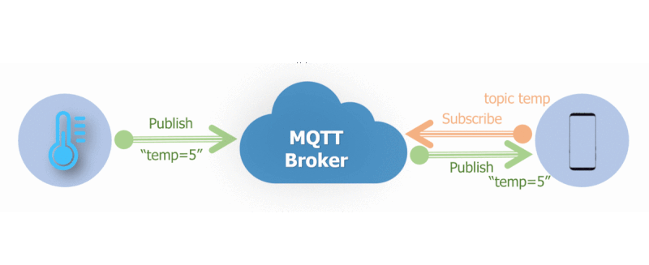
What is a Topic
MQTT Topic is a string that is used to route messages. We can create multiple hierarchies by using slash /, similar to a URL. A Publisher client can publish a message on a topic and a Broker delivers the message to all the Clients that has subscribed to that topic.
Topic :
sensor/1/temperature
sensor/2/humidity
software-update/android/14/
software-update/android/14/2
software-update/ios/17
software-update/ios/17/
Topic…!!
An MQTT Topic is an identifier or a filter for the message.
For example, a temperature sensor can send a message with the following topic “temperature/house/floor1/room3”.

Slide 13
What is a Message
What is a Publisher
The message is the payload of the MQTT publication for a specific topic.
Following the same temperature example, the message can be “20 degrees Celsius”
An MQTT publisher sends messages with a topic to a MQTT Broker
What is a Broker
What is a Subscriber
A broker is a server that receives MQTT messages as input from publishers and in turn publish them to subscribers.
An MQTT subscriber “subscribes” to particular topics available on a MQTT Broker and can read the related messages.
A subscriber can ask for specific topics “temperature/house/floor1/room3” or wildcard the topics to get all messages under a specific topic level. For example: I can read all MQTT messages related to temperature by subscribing to “temperature/#”
Who is the Client, who is the Server?
A client is a device or an application, such as an IoT device or a mobile app, making an MQTT connection to the broker.

Slide 14
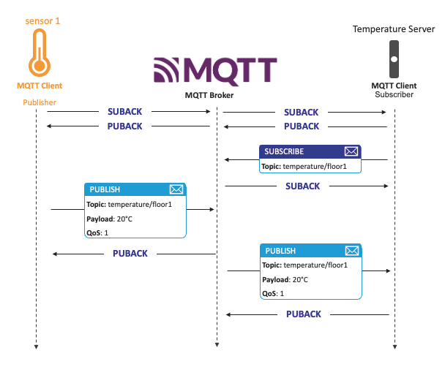
B: Traffic

Slide 15
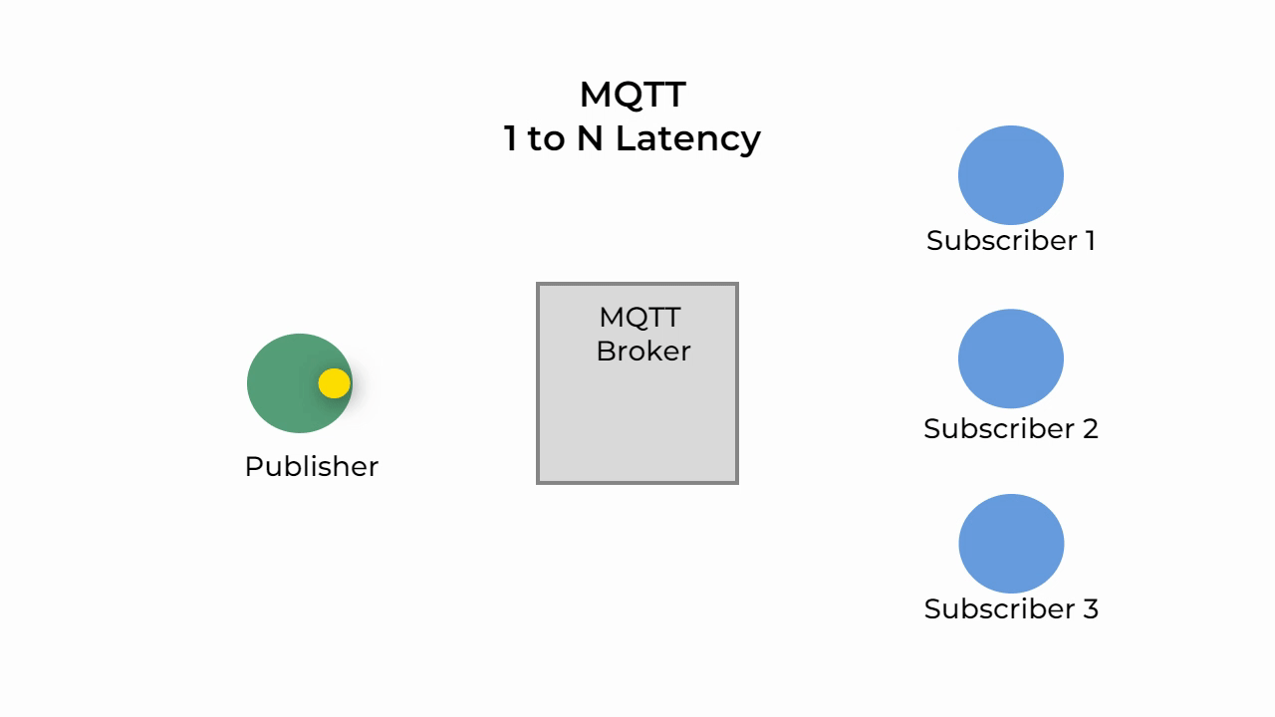
C: Message Queue Telemetry Transport (MQTT)
What is Publisher-subscriber
The Publisher-Subscriber model, unlike the Client-Server, the client that sends the message (Publisher) is unaware of the existence of the client that receives the message (Subscriber). Clients do not connect to each other directly they connect to the Broker which is responsible for routing the messages. The MQTT Broker uses Topics for routing messages to the exact subscribed client.
Notes:
https://medium.com/nerd-for-tech/everything-to-know-about-mqtt-message-queue-telemetry-transport-acbf32d1b761

Slide 16
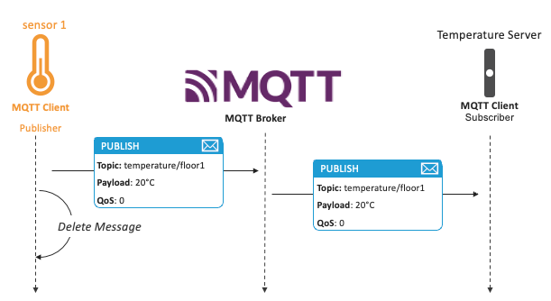
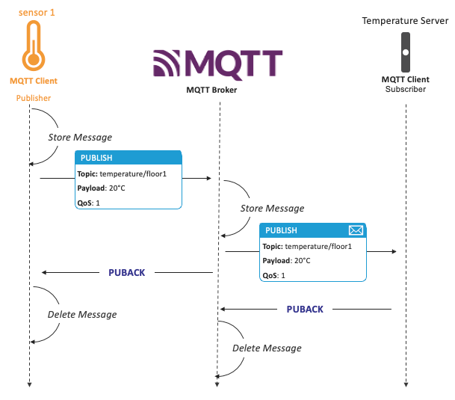
The reality is we are delivering messages to and from constrained devices over unreliable networks. When consider a temperature sensor, it may be not so catastrophic to miss a temperature measurement within a 5-minute time slot, but for other use cases like healthcare or automotive, omissions can have tragic consequences. Therefore, we need to consider Quality of Service (QoS) levels that can be associated with MQTT implementations.
MQTT has 3 levels of QoS:
- QoS 0 – “at most once” aka fire and forget: the message is sent without confirmation or follow-up
- QoS 1 – “at least once”: the publisher keeps a copy of the published message until it receives a PUBACK confirmation reception message from the broker. If it does not receive a successful receipt message from the broker before expiration of a timeout period, it resends the message.

Slide 17
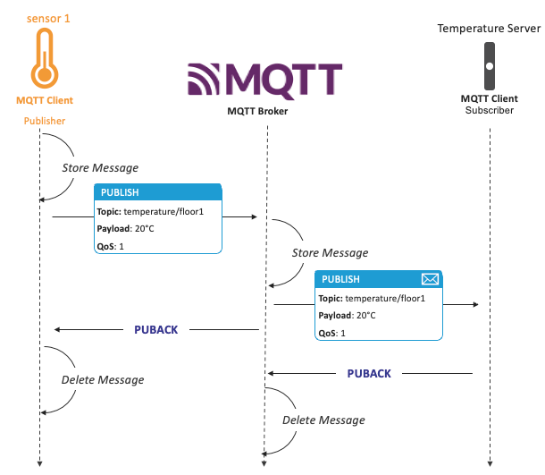
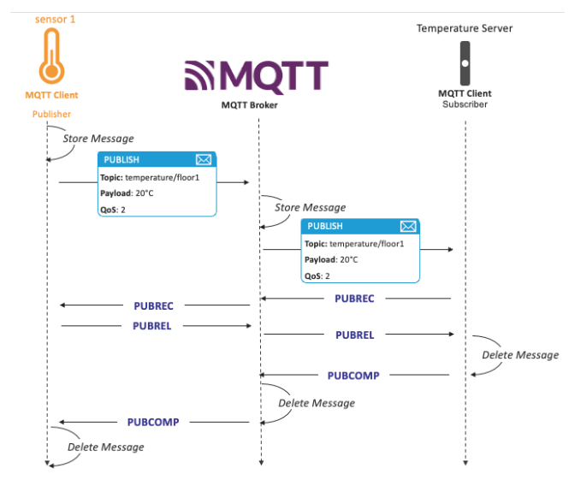
- QoS 2 – “exactly once”: when the publisher sends a message to the broker, it expects a PUBREC acknowledgement. On receiving the PUBREC, the sender removes the packet and sends a PUBREL to tell the broker to release the message If it does not receive any during a timeout period, it sends the PUBLISH packet with a duplicate flag (DUP)
So, how to select an appropriate QoS value? First, I would say: just put “2” and add to it “which can do more can do less” but I think again at the constrained devices. The higher the QoS level, the more bandwidth and compute it requires.
Here are few tips on how to choose the best QoS:
- QoS0 is faster than QoS1 which is faster than QoS2.
- Use QoS0 if you have a very reliable network.
- QoS1 tolerates duplicate messages.
- Use QoS0 when you don’t mind losing some message occasionally.
Notes:
https://community.f5.com/kb/technicalarticles/what-is-message-queue-telemetry-transport-mqtt-how-to-secure-mqtt/332019

Slide 18
C-1: What is QOS
MQTT QoS levels?
There are three levels to note in MQTT QoS: 0, 1, 2. We’ve summarized what each level means below:
QoS 0: at most once
QoS 1: at least once
QoS 2: exactly once
There are three levels to note in MQTT QoS: 0, 1, 2. We’ve summarized what each level means below:
QoS | Publisher | Subscriber
0: at most once | Will send a message only once. | Might receive or might not receive the message.
1: at least once | Will send a message at least once as long as an acknowledgement is received or the command to end the transmission is received. | It is likely to receive the message at least once (it is possible that the message can be received more than once).
2: exactly once | Will only send a message once. | Will only receive the message once.
Notes:
https://cedalo.com/blog/understanding-mqtt-qos/

Slide 19
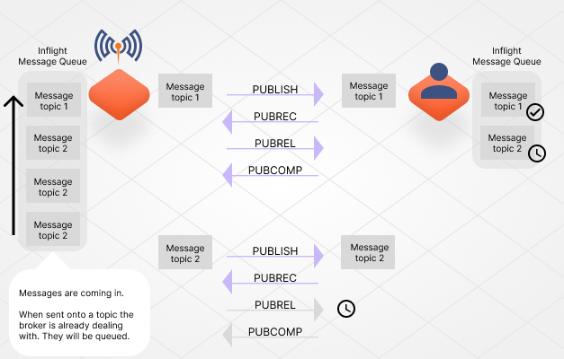

Slide 20
C-1: What is QOS
QOS or Quality of Service basically means the message delivery reliability. MQTT offers three levels of QOS.
QOS 0: The message is delivered at most once. If the client is not available currently, it will lose this message.
QOS 1: The message is delivered at least once.
QOS 2: The message is delivered only once.

Slide 21
Why is Quality of Service (QoS) Important?
Why is Quality of Service (QoS) Important?
When discussing QoS in MQTT, it’s important to consider message delivery from the publishing client to the broker and from the broker to the subscribing client. These two aspects of message delivery have subtle differences.
The client that publishes a message to the broker defines the QoS level for the message during transmission. The broker then transmits the message to subscribing clients using the QoS level defined by each subscribing client during the subscription process. If the subscribing client defines a lower QoS level than the publishing client, the broker will transmit the message with the lower QoS level.
Understanding how message delivery works in MQTT sets the foundation for appreciating the significance of Quality of Service (QoS) levels in ensuring reliable communication between the publishing client, broker, and subscribing client.
Quality of Service (QoS) is crucial in MQTT due to its role in providing the client with the ability to select a service level that aligns with both the network reliability and the application’s requirements. MQTT’s inherent capability to handle message re-transmission and ensure delivery, even in unreliable network conditions, makes QoS essential for facilitating seamless communication in such challenging environments. By offering different QoS levels, MQTT empowers clients to optimize their network usage and achieve the desired balance between reliability and efficiency.
Now that we understand the significance of Quality of Service (QoS) in MQTT, let’s delve into the inner workings of QoS and explore how it operates to ensure reliable message delivery in varying network conditions.

Slide 22
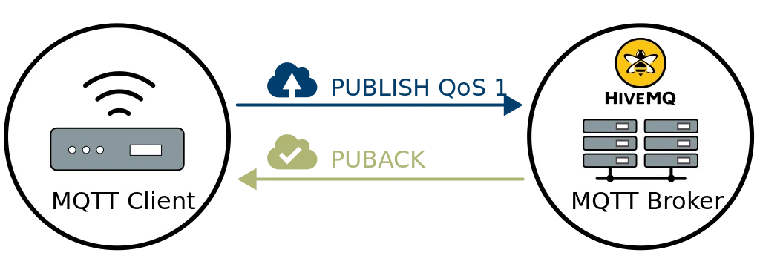
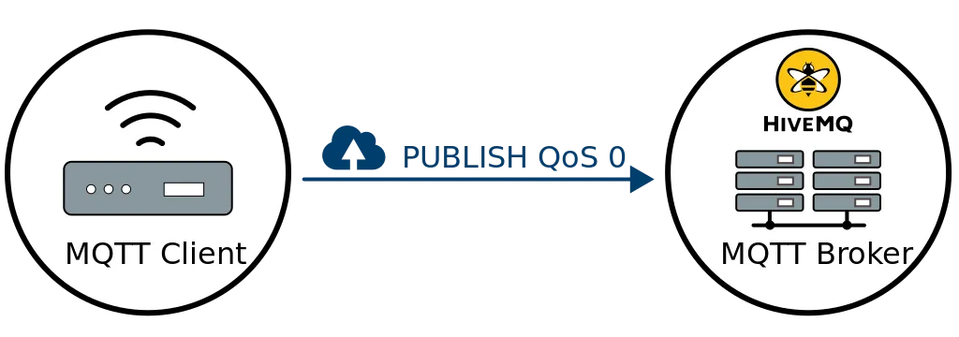
How does QoS 0 work in MQTT?
How does QoS 1 work in MQTT?
At the lowest level, QoS 0 in MQTT offers a best-effort delivery mechanism where the sender does not expect an acknowledgment or guarantee of message delivery. This means that the recipient does not acknowledge receiving the message, and the sender does not store or re-transmit it. QoS 0, commonly called “fire and forget,” functions akin to the underlying TCP protocol, where the message is sent without further follow-up or confirmation.
In QoS 1 of MQTT, the focus is on ensuring message delivery at least once to the receiver. When a message is published with QoS 1, the sender keeps a copy of the message until it receives a PUBACK packet from the receiver, confirming the successful receipt. If the sender doesn’t receive the PUBACK packet within a reasonable time frame, it re-transmits the message to ensure its delivery.
Quality of Service level 0: delivery at most once
Quality of Service level 1: delivery at least once

Slide 23
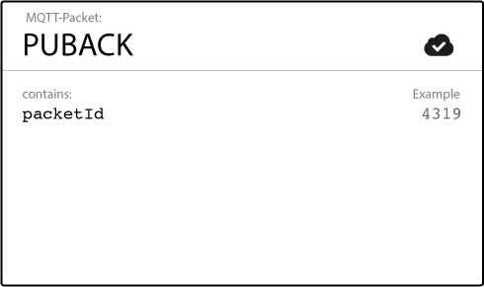
Upon receiving the message, the receiver can process it immediately. For example, if the receiver is an MQTT broker, it distributes the message to all subscribing clients and responds with a PUBACK packet to acknowledge the receipt of the message.
MQTT PUBACK packet
It’s important to note that in QoS 1, if the publishing client sends the same message again, it sets a duplicate (DUP) flag. However, this flag is used for internal purposes and is not processed by the broker or client. Regardless of the DUP flag, the receiver still sends a PUBACK packet to acknowledge the receipt of the message, ensuring the sender is aware of the successful delivery.
This approach of QoS 1 strikes a balance between reliability and efficiency, guaranteeing that the message reaches the receiver at least once while allowing for potential duplicates to be handled appropriately.

Slide 24
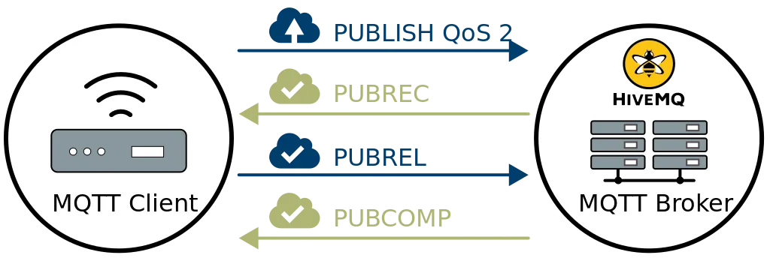

How does QoS 2 work in MQTT?
QoS 2 offers the highest level of service in MQTT, ensuring that each message is delivered exactly once to the intended recipients. To achieve this, QoS 2 involves a four-part handshake between the sender and receiver.
When a receiver gets a QoS 2 PUBLISH packet from a sender, it processes the publish message accordingly and replies to the sender with a PUBREC packet that acknowledges the PUBLISH packet. If the sender does not get a PUBREC packet from the receiver, it sends the PUBLISH packet again with a duplicate (DUP) flag until it receives an acknowledgment.
MQTT Quality of Service level 2: delivery exactly once

Slide 25


MQTT PUBREC packet
MQTT PUBREL Packet
Once the sender receives a PUBREC packet from the receiver, the sender can safely discard the initial PUBLISH packet. The sender stores the PUBREC packet from the receiver and responds with a PUBREL packet, the receiver discards all stored states and replies with a PUBCOMP packet.
After the receiver gets the PUBREL packet, it can discard all stored states and answer with a PUBCOMP packet (the same is true when the sender receives the PUBCOMP). Until the receiver completes processing and sends the PUBCOMP packet back to the sender, the receiver stores a reference to the packet identifier of the original PUBLISH packet. This step is important to avoid processing the message a second time.
After the sender receives the PUBCOMP packet, the packet identifier of the published message becomes available for reuse.

Slide 26
What are the Key Considerations for QoS in MQTT?
MQTT PUBCOMP Packet
When the QoS 2 flow is complete, both parties are sure that the message is delivered and the sender has confirmation of the delivery.
If a packet gets lost along the way, the sender is responsible to retransmit the message within a reasonable amount of time. This is equally true if the sender is an MQTT client or an MQTT broker. The recipient has the responsibility to respond to each command message accordingly.
While understanding QoS in MQTT, there are several important aspects to keep in mind:
Downgrade of QoS
The QoS levels defined by the sender and receiver can differ. The client sending the message to the broker defines the QoS level, while the broker uses the QoS defined by the receiver during subscription. For example, if the sender uses QoS 2 and the receiver subscribes with QoS 1, the broker delivers the message to the receiver with QoS 1. This can result in multiple deliveries of the same message to the receiver.
Notes:
https://www.hivemq.com/blog/mqtt-essentials-part-6-mqtt-quality-of-service-levels/

Slide 27
Packet identifiers are unique per client
What are the Best Practices While Using MQTT Quality of Service (QoS) 0,1, & 2?
Packet identifiers used for QoS 1 and 2 are unique between a specific client and a broker within an interaction. However, they are not unique across all clients. Once a flow is complete, the packet identifier becomes available for reuse. This is why the packet identifier does not need to exceed 65535 , as it is unrealistic for a client to send more messages than that without completing an interaction
We are often asked for advice about how to choose the correct QoS level. Selecting the appropriate QoS level depends on your specific use case. Here are some guidelines to help you make an informed decision:
Use QoS 0 when:
You have a completely or mostly stable connection between sender and receiver. A classic use case for QoS 0 is connecting a test client or a front end application to an MQTT broker over a wired connection.
You don’t mind if a few messages are lost occasionally. The loss of some messages can be acceptable if the data is not that important or when data is sent at short intervals
You don’t need message queuing. Messages are only queued for disconnected clients if they have QoS 1 or 2

Slide 28
Use QoS 1 when:
Queuing of QoS 1 and 2 messages
You need to get every message and your use case can handle duplicates. QoS level 1 is the most frequently used service level because it guarantees the message arrives at least once but allows for multiple deliveries. Of course, your application must tolerate duplicates and be able to process them accordingly.
You can’t bear the overhead of QoS 2. QoS 1 delivers messages much faster than QoS 2.
All messages sent with QoS 1 and 2 are queued for offline clients until the client is available again
Use QoS 2 when:
It is critical to your application to receive all messages exactly once. This is often the case if a duplicate delivery can harm application users or subscribing clients. Be aware of the overhead and that the QoS 2 interaction takes more time to complete.

Slide 29
C-2: MQTT WorkFlow
Since we are now aware of all the components of an MQTT let's see how a message is created and delivered from start to end.
The client initiates a connection to the MQTT broker. This step also includes client authentication and session creation.
The client either subscribes to a Topic or publishes a message to a specific topic. The Publishing client sends a message to the Broker while the Subscriber informs the Broker of its interest in any message that has been published on the topic.
The Broker receives the published message and forwards the message to all the clients that have subscribed to that topic.

Slide 30
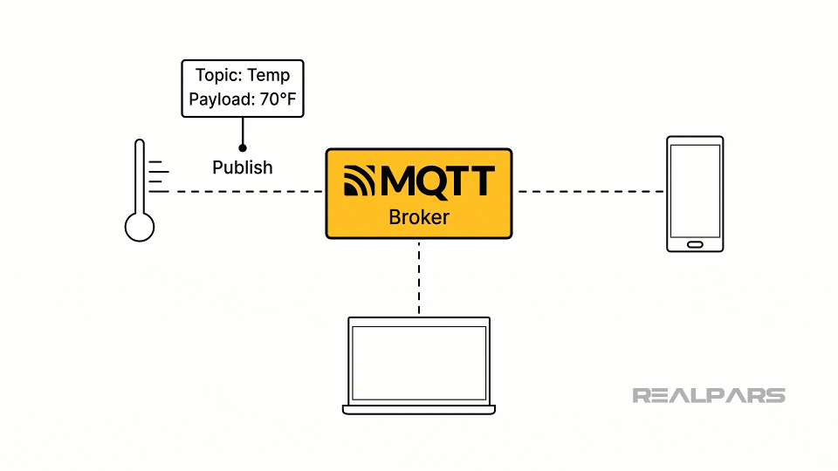

Slide 31
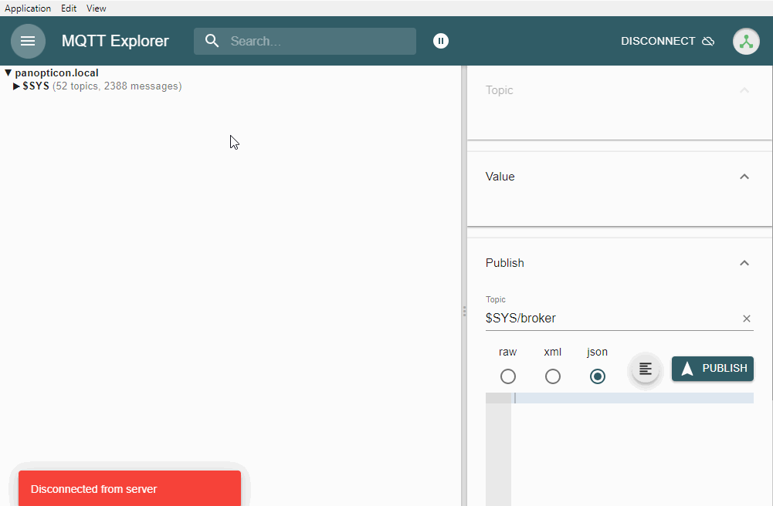
Notes:
https://www.google.com/imgres?q=MQTT%20WorkFlow%20gif&imgurl=https%3A%2F%2Fuser-images.githubusercontent.com%2F159567%2F72214338-ee9c4d80-3553-11ea-90a4-d86af267f870.gif&imgrefurl=https%3A%2F%2Fgithub.com%2Fthomasnordquist%2FMQTT-Explorer%2Fissues%2F283&docid=SbWewKyuVHIuqM&tbnid=xx4B1uK4kk63PM&vet=12ahUKEwivhZGV1suJAxXuV2wGHfe5InEQM3oECF0QAA..i&w=1001&h=656&hcb=2&ved=2ahUKEwivhZGV1suJAxXuV2wGHfe5InEQM3oECF0QAA
https://www.realpars.com/blog/node-red-mqtt-plcnext

Slide 32
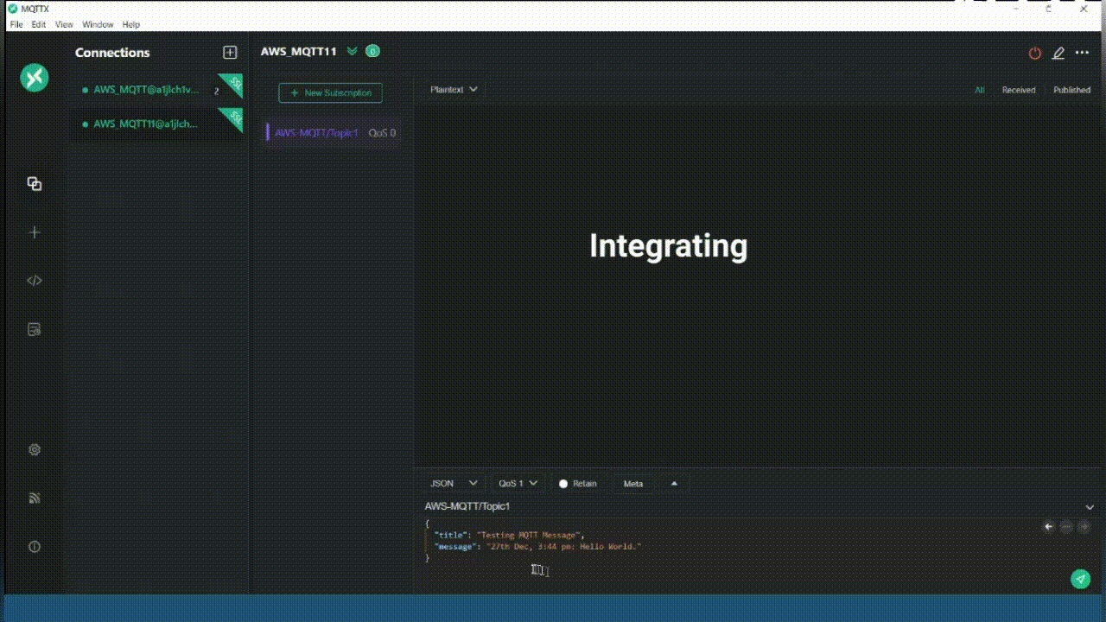
Mqttx Client with AWS Mqtt Broker

Slide 33
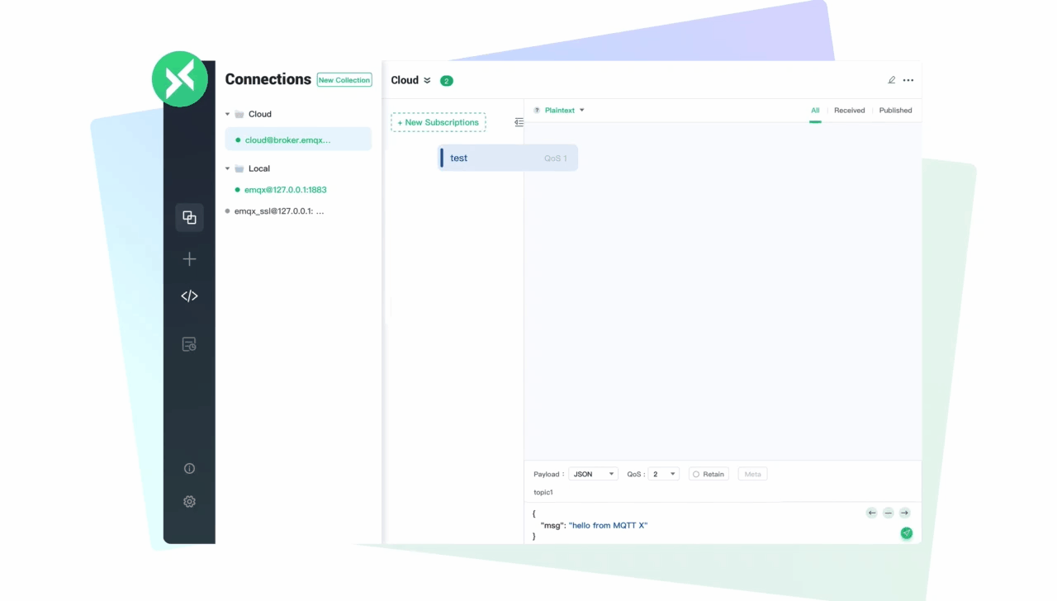
Notes:
https://medium.com/nerd-for-tech/mqttx-client-with-aws-mqtt-broker-7e7007dc023b
https://medium.com/nerd-for-tech/mqttx-client-with-aws-mqtt-broker-7e7007dc023b

Slide 34
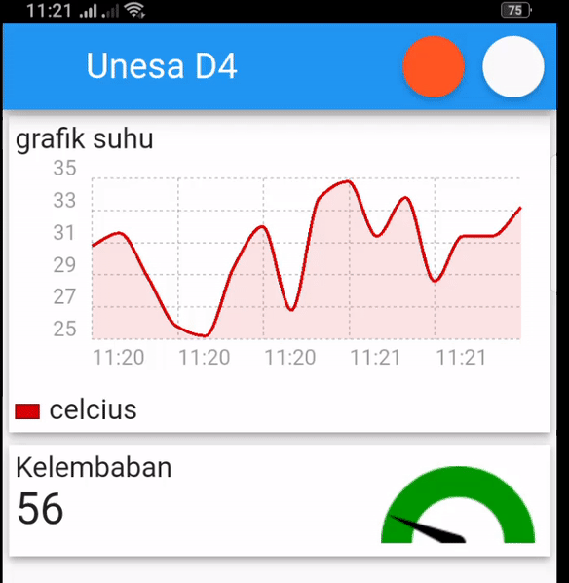
Suhu dan Kelembaban
Temperature
Humidity

Slide 35
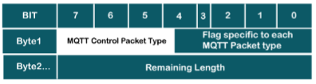
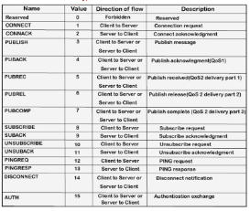
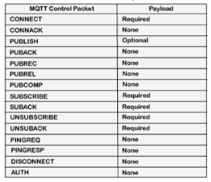
C-3 : MQTT is a publish-subscribe based messaging protocol that works on top of TCP/IP protocol
Frame Header
MQTT Packet Control
CoAP

Slide 36
C-3 : MQTT is a publish-subscribe based messaging protocol that works on top of TCP/IP protocol
Aspects of MQTT protocol
To communicate with each other, publisher and subscriber only needs to know IP and port of the broker and a common Topic. This removes dependency of each client knowing address of other client.
Even though most messages are delivered on the go, MQTT also supports storing of messages. If desired, broker can store these messages when a client is not online. For this client needs to connect using a persistent session with QOS greater than zero.
MQTT mostly works in synchronous manner which results in no lagging in delivery.
MQTT uses subject based filtering and broker uses Topics to decide on which subscriber is to receive which message.
A temperature sensor publishes real-time temperature values to “temp” topic on MQTT-Broker.
Broker then multicasts this information to all devices that had subscribed to topic “temp”.
Notes:
https://nitin-sharma.medium.com/getting-started-with-mqtt-part-1-a3c365e3a488

Slide 37
C-3 : MQTT is a publish-subscribe based messaging protocol that works on top of TCP/IP protocol
MQTT - Client
In MQTT, both publishers and subscribers are clients.
A client can act both as a publisher or subscriber and name only signifies sending or receiving party.
Ease of implementation and MQTT-client’s ability to work on low bandwidth network is what makes it perfect to use in IOT based devices.
Micro-controllers, pi, AWS servers running on MQTT can act as clients.
Notes:
https://nitin-sharma.medium.com/getting-started-with-mqtt-part-1-a3c365e3a488

Slide 38
C-3 : MQTT is a publish-subscribe based messaging protocol that works on top of TCP/IP protocol
MQTT - Broker
Broker acts as a mediator between publisher and subscriber.
MQTT brokers can handle thousands of messages at a time due to its simplified architecture. Here is a comparison between MQTT and HTTP protocols.
Work done by broker : Receive all messages, filter these messages, find out subscribers to a particular topic, Send these message to those subscribed clients.
Broker can also hold missed messages of persisted clients which can be sent to it once he comes online again. This is important for a case when some client gets disconnected unwillingly.
Broker is also responsible for handling authentication and authorization.
Notes:
https://nitin-sharma.medium.com/getting-started-with-mqtt-part-1-a3c365e3a488

Slide 39
C-3 : MQTT is a publish-subscribe based messaging protocol that works on top of TCP/IP protocol
MQTT - Connection
MQTT broker and clients both are TCP/IP based.
Connection is always between one broker and one client.
Some important parameters needed for the connection :
“clientId” : should be unique per client and is needed to maintain state of the client. This will help to deliver new messages to the client which were not delivered to it when it was offline.
“cleanSession” : equals to false, if you want to establish persistent session and store these subscriptions.
“username/password” : sent as plain text if not encrypted.
“willMessage” : message to be sent by the disconnecting client to all clients of that topic in case it gets disconnected.
Need for Client-ID : Client-ID is needed to identify an application mainly when a client is using persistent subscriptions. When these subscriptions are offline, broker creates a backup of messages been delivered to them and when such applications come on-line again, a messaging provider has to identify these subscriptions and there messages. Broker then compares the persisted client-id across clients that came online and delivers messages to them.
Notes:
https://nitin-sharma.medium.com/getting-started-with-mqtt-part-1-a3c365e3a488

Slide 40
C-3 : MQTT is a publish-subscribe based messaging protocol that works on top of TCP/IP protocol
Publisher/Subscriber in MQTT
A MQTT Publisher client can start publishing messages as soon as it connects to the broker. Each message will contain a topic and payload to be sent.
A MQTT Subscriber are tthe ones that receives messages that are published to a particular topic.
Notes:
https://nitin-sharma.medium.com/getting-started-with-mqtt-part-1-a3c365e3a488

Slide 41
C-3 : MQTT is a publish-subscribe based messaging protocol that works on top of TCP/IP protocol
MQTT - Topics
MQTT-Topic is a string that broker uses to filter messages. Only subscribers of a particular topic receives messages published to that topic.
Topics consist of topic levels separated by a “/”. Example : “home/ground/room/temp”
Properties : 1. Must contain atleast 1 character 2. Can contain empty spaces 3. “/” is a valid topic name
“MQTT-Topics” is an interesting concept. Click here for further information or read AWS guide on “MQTT-Topic”.
Notes:
https://nitin-sharma.medium.com/getting-started-with-mqtt-part-1-a3c365e3a488

Slide 42
C-3 : MQTT is a publish-subscribe based messaging protocol that works on top of TCP/IP protocol
There are few more topics that needs your attention :
Quality of Service : QOS is a key feature of the MQTT protocol which gives client a power to choose among different level of services that matches its network reliability and application logic. Because MQTT manages the re-transmission of messages and guarantees delivery (even when the underlying transport is not reliable), QOS makes communication in unreliable networks a lot easier.
Persistent Session in MQTT : In MQTT a client can request a persistent session when it connects to the broker. Persistent sessions save all information that is relevant for the client on the broker. Read : AWS Doc, IBM Doc.
Last Will : This basically is a message that will notify other clients subscribed to a particular topic that this client has lost connection. HiveMQ Read explains it in details.
Notes:
https://nitin-sharma.medium.com/getting-started-with-mqtt-part-1-a3c365e3a488

Slide 43
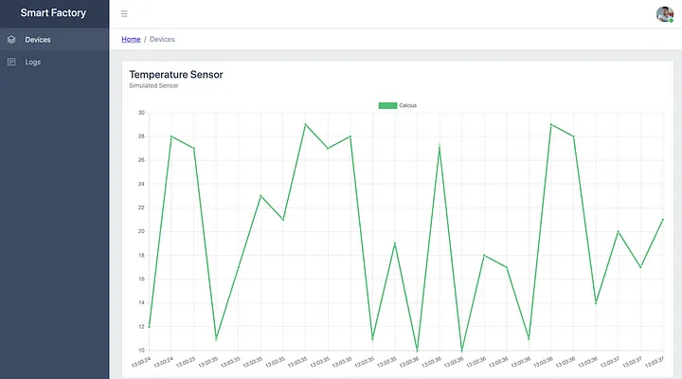
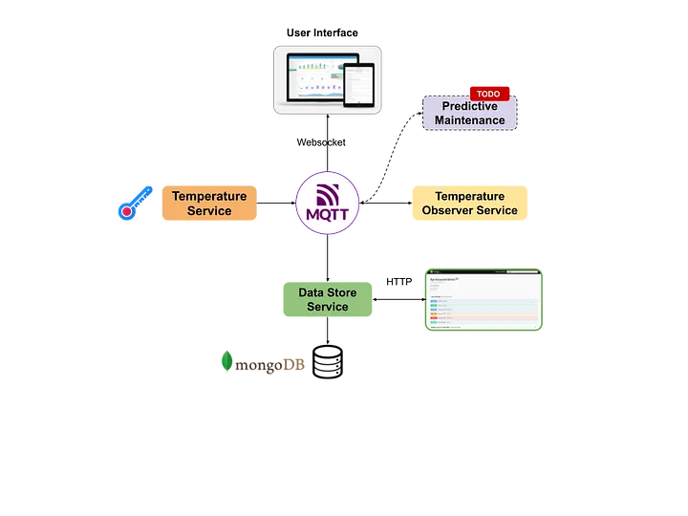
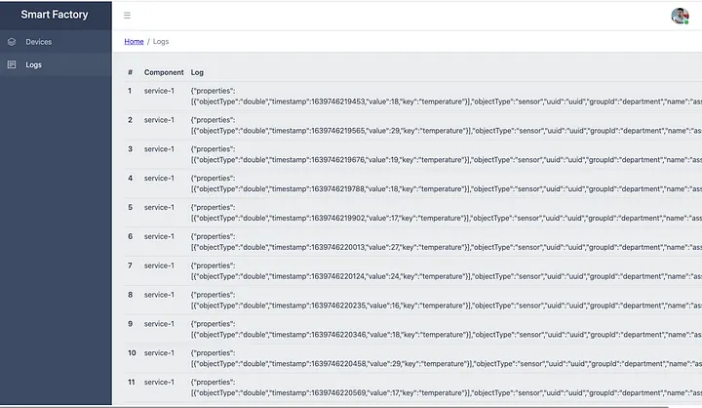
Project: IoT_A
https://github.com/siagianp/IoT-A
Notes:
Quick Start
Use Case
System Architecture
Required Technologies
System Components
MQTT Broker Configuration
IoT Data Model Design
Simulated IoT Sensor Implementation
Data Processing&Observer Service Implementation
Data Storing&Requesting Service Implementation
User Web Interface Implementation
Predictive Maintenance Service Implementation (TODO)
6. Future Works
https://github.com/Fillo22/IoT-Monitoring
https://medium.com/nerd-for-tech/creating-a-simple-iot-project-590342f6f904
https://github.com/cemakpolat/simple-iot-project
https://thingsboard.io/docs/samples/raspberry/temperature/
https://github.com/fahdarhalai/IoTTempMonitoringSystem
https://medium.com/nerd-for-tech/creating-a-simple-iot-project-590342f6f904
npm install

Slide 45
Thank you!
PDS
Computer Vision
Thank you For being a great class!
https://github.com/siagianp
https://www.youtube.com/@AmelOline/videos
https://github.com/amelcharolinesgn2/IoT_simulator-mqtt-NodeRed
https://github.com/amelcharolinesgn2/Cloud-Infrastructures
https://github.com/amelcharolinesgn2/ClouD-Infrastructure-SISKA-2025
Notes:
https://medium.com/buildpiper/simplifying-containerization-with-docker-run-command-2f74e114f42a
https://github.com/IBA-Group-IT/IoT-data-simulator
https://www.bevywise.com/blog/docker-mqtt-broker-easy-service-manageability/

